Slide 1
Qt Essentials
January 2016
Based on Qt 5.6
N.N.
N.N@company.com

Slide 2
Contents
Fundamentals | What Is Qt? Qt 5 Modules Licensing Options Creating, Building, and Debugging Applications with QtCreator Practical Tips for Developers Practical Tips for Developers Logging Messages, Asserts
Objects in Qt | Communication Using Signals & Slots Signal/Slot Variations Handling Events in Qt
Core Classes | Qt's Object Model QObject Qwidget Variants Properties String Handling Container Classes

Slide 3
Objectives
To get a good practical experience on
QtCreator
Qt modules
Qt licenses
Meta-Object System
Essential class types in the core module
To be able to start serious Qt development or continue efficient Qt development after the training
Any questions at any point – please do not hesitate to ask!

Slide 4
Fundamentals

Slide 5
Contents
What Is Qt?
Qt 5 Modules
Licensing Options
Creating, Building, and Debugging Applications with QtCreator
Practical Tips for Developers
Logging Messages, Asserts

Slide 6
The Leading C++ Cross-Platform Framework
Cross-Platform Class Library
One Technology for All Platforms
Integrated Development Tools
Shorter Time-to-Market
Cross-Platform IDE, Qt Creator
Productive development environment
Used by over 800,000 developers in 70+ industries
Proved & tested technology – since 1994

Slide 7
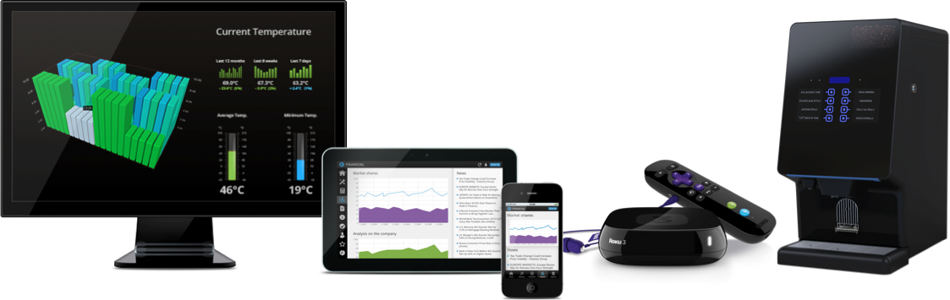
Qt is Used for
Application
Development
on Desktop,
Mobile and Embedded
Creating
Powerful Devices
Device GUIs,
Ecosystems and whole SDKs

Slide 8
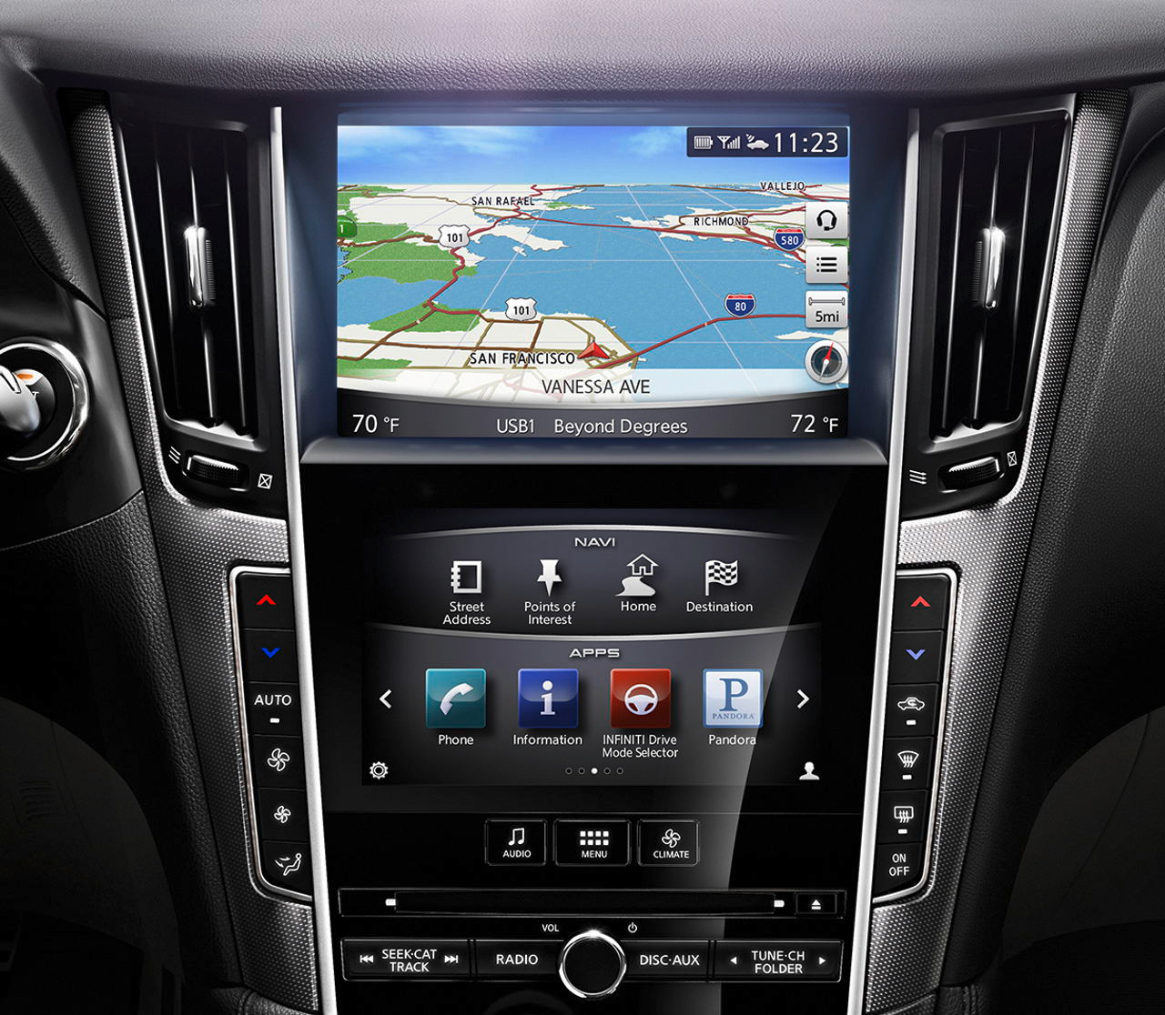
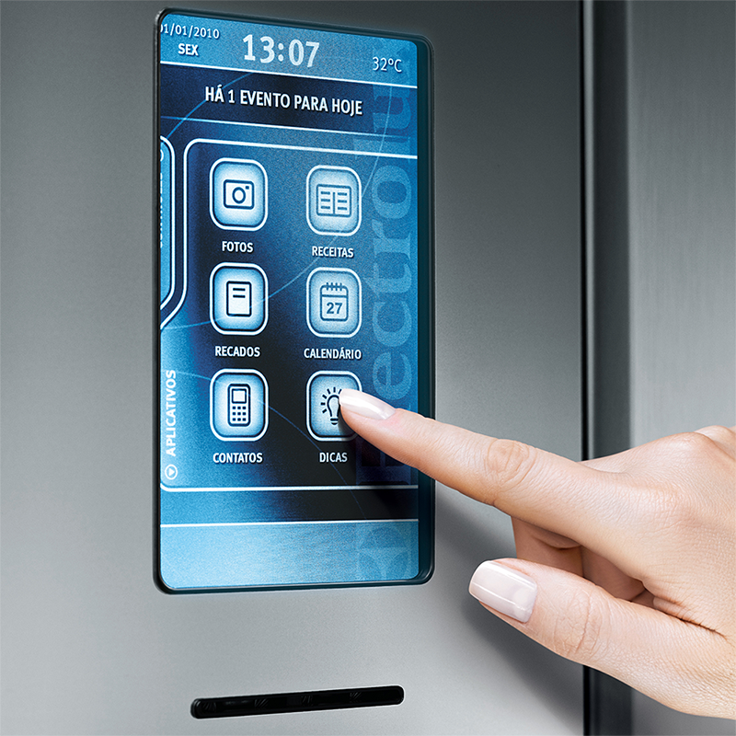
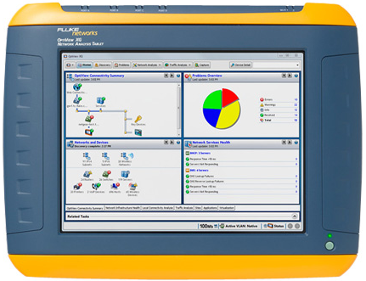
Where There’s a User Interface, There’s Qt
Automotive IVI
Refrigerators & Coffee Machines
Network Analyzers
Plus:
Medical Devices
Home Automation
Digital Photo Frames
Set Top Boxes
Industrial/UMPCS
and many, many more …

Slide 9






Qt is Used Everywhere
5000+ Companies from 70+ industries use Qt

Slide 10
Satisfaction is High
5
out of Top 10 Fortune 500 Companies Are Powered by Qt!
95%
of Qt Developers
Are Satisfied with Qt Overall*
*Qt Insights survey 2013, (n=1862)

Slide 11
Qt Applications Are Native Applications
Qt / Windows
Windows GDI
Windows Kernel
PC HW
Qt Application
Qt / OSX
Cocoa
Mac Kernel
MacHW
Qt / Embedded
X11, Wayland, EGLFS
Linux Kernel
Embedded HW
Qt / Android
Android NDK
Android Kernel
Android HW
QtGui
QtCore
QtNetwork
QtSql
QtMultimedia
etc.

Slide 12
Qt Developer Offering, Cross-Platform APIs
Essentials
Widgets
C++
Native LAF
Layouts
Styles
OpenGL
Qt Quick
QML
Controls
Layouts
Styles
OpenGL
WebEngine
+ WebView
HTML 5
Hybrid UIs
Add-ons
Charts
GUI
SVG
Data Visualization
Canvas 3D
Virtual Keyboard
Core
Processes
Threads
IPC
Containers
I/O
Strings
Etc.
Multimedia
Audio
Video
Radio
Camera
Network
HTTP
FTP
TCP/UDP
SSL
Serial Port
Bluetooth
Positioning
Concurrency
Printing
Scripting
non-GUI
NFC
Platform Extras
Sql
SQL and Oracle databases
Qt Test
XML
Sensors
Image formats
In-App Purchasing

Slide 13
Qt Licensing since 5.7
Qt Essentials and Add-ons available under LGPLv3, GPLv2, and commercial license
Qt WebEngine has LGPLv2.1 requirement
Add-ons, which were available under commercial license prior Qt 5.7, are also available under GPLv3
Qt Tools and Applications are available under GPLv3 and commercial license
GPL v3
The original one, strict open source license
All your own code, IPR etc., will also have to be GPL licensed
No commercial possibilities without opening own source code
LGPL v3
In short forbids creation of closed devices
Adds additional requirements making it less attractive in commercial usage
Mainly DRM restrictions, patent retaliation limitations, and Tivoization.
⇒ Let’s The Qt Company contribute new features to Qt under LGPL

Slide 14

“Hello World” in Qt
// main.cpp
int main(int argc, char *argv[])
{
QApplication app(argc, argv);
QPushButton button("Hello world");
button.show();
return app.exec();
}
Program consists of
main.cpp – application code
helloworld.pro – project file
Demo: ex-helloworld

Slide 15
Project File - helloworld.pro
helloworld.pro file • lists source and header files • provides project configuration
Assignment to variables
Possible operators =, +=, -=
# File: helloworld.pro
greaterThan(QT_MAJOR_VERSION, 4): QT += widgets
TEMPLATE = app
SOURCES = main.cpp
Documentation: qmake Manual

Slide 16
Using qmake
qmake tool
Creates cross-platform make-files
Build project using qmake
Tip: qmake –project
Creates default project file based on directory content
Qt Creator dos it all for you
cd helloworld qmake helloworld.pro # creates Makefile make # compiles and links application
./helloworld # executes application

Slide 17
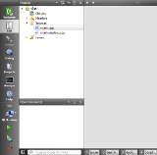
Building Qt Applications
Qt Project
qmake
[Linux/X11]
Makefile
App
in
Linux
GCC
[Linux compiler]
Qt/C++
code files
.pro
file
Qt/C++
code files
Qt/C++
code files
qmake
[Embedded Linux]
Makefile
Cross compiler
App
in
Target HW
qmake
[INTEGRITY]
.gpj
App
in
Target HW
Other IDE / Code Editor
MULTI
Native tool chains
Qt Creator

Slide 18
Useful qmake Variables
TEMPLATE - Defines the type of project
app, vcapp
lib, vclib
subdirs
TARGET
Name of the executable (by default equals to the .pro file name)
QT
Qt-specific modules and their dependencies defined in mkspecs/modules
QT += webkit sql network charts
CONFIG
Specifies a project configuration or compiler option – used internally by qmake
May refer to a project feature a .prf file in mkspecs/features
Custom features can be added using CONFIG += myFeatures
INCLUDEPATH and DEPENDPATH
Sets the include search path (-I option)
RESOURCES
Specifies resource collection (.qrc) files to include in build
LIBS
DEFINES
INSTALLS
Files and folders to be copied after building (make install)
Hint! Additional variables and values may be defined in the command line:
qmake “CONFIG += debug”

Slide 19
Qmake Usage
Scopes
win32:debug { SOURCES += paintwidget_win.cpp }
Single line conditional assignment
win32:DEFINES += QT_DLL
Environment variable reference
DESTDIR = $$PWD # Evaluated when the .pro file is processed (qmake executed)
DESTDIR = $PWD # Evaluated when the Makefile is executed
Variable reference
TARGET = myproject_$${TEMPLATE}
Configuration options
You may ask the options with the command qmake –query
message(Qt version: $$[QT_VERSION])
Hint! You may define project dependencies in the declarative way using Qt Build Suite (QBS).
http://wiki.qt.io/Qt_Build_Suite

Slide 20
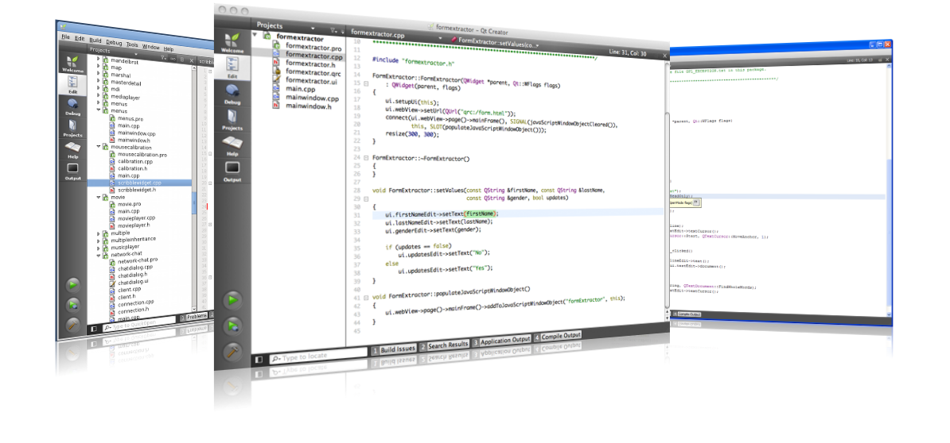
QtCreator IDE
Advanced C++ code editor
Integrated GUI layout and forms designer
Project and build management tools
Integrated, context-sensitive help system
Visual debugger
Rapid code navigation tools
Supports multiple platforms

Slide 21
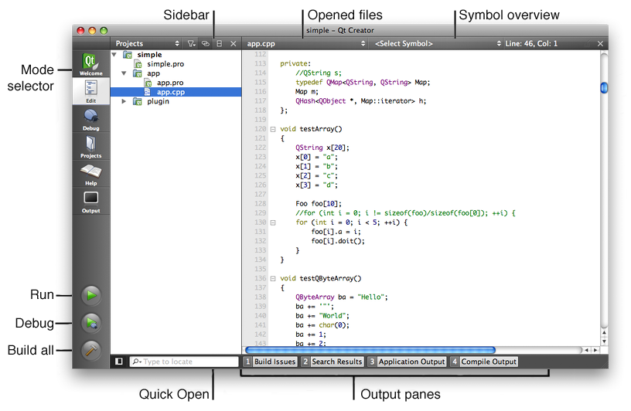
Overview of Qt Creator Components

Slide 22
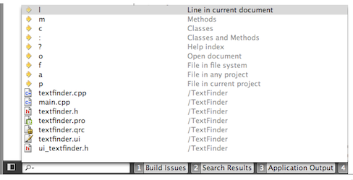
Finding Code – Locator
Click on Locator or press Ctrl+K (Mac OSX : Cmd+K)
Type in the file name
Press Return
Locator Prefixes
:<class name> - Go to a symbol definition
l<line number> - Go to a line in the current document
?<help topic> - Go to a help topic
o<open document> - Go to an opened document

Slide 23
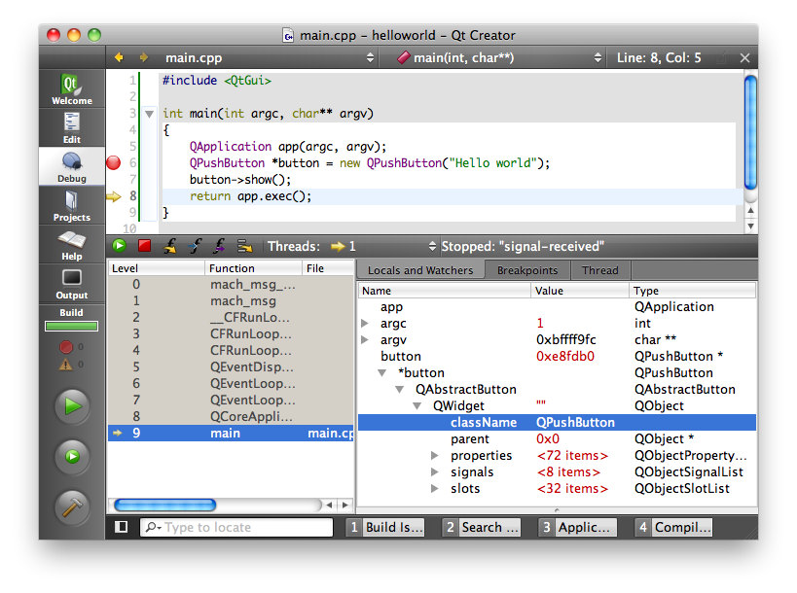
Debugging an Application
Debug −> Start Debugging (o rF5)

Slide 24
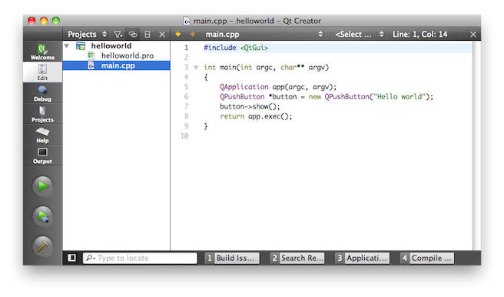
Qt Creator Demo "Hello World"
What we'll show:
Creation of an empty Qt project
Adding the main.cpp source file
Writing of the Qt Hello World Code
Showing Locator Features
Running the application
Debugging the application
Looking up the text property of our button

Slide 25
Practical Tips for Developers

Slide 26
How Much C++ Do You Need to Know?
Objects and classes
Declaring a class, inheritance, calling member functions etc.
Polymorphism
That is virtual methods
Operator overloading
Templates
For the container classes only
C++11/14 useful
No…
...RTTI
...sophisticated templates
...exceptions thrown
...

Slide 27
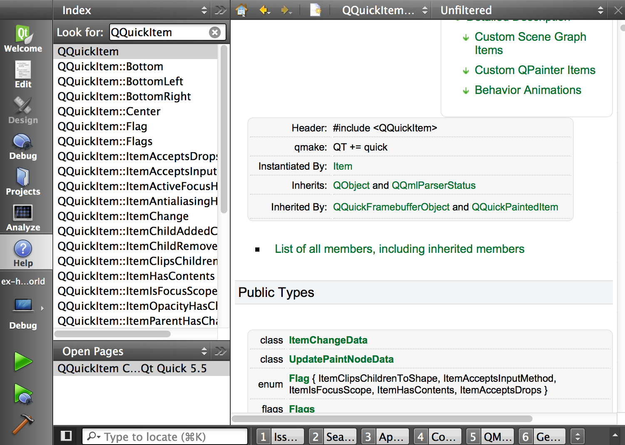
Qt Documentation
Reference Documentation
All classes documented
Contains tons of examples
Collection of Howto's and Overviews
A set of Tutorials for Learners

Slide 28
Finding the Answers
I need answers ASAP
Join the IRC channel, related to the problem area and ask the professionals for help – https://wiki.qt.io/Online_Communities
Support - http://www.qt.io/support/
Discussion forums
Qt Centre - http://www.qtcentre.org/content/
It does not work
Bug reporting and finding - https://bugreports.qt.io/secure/Dashboard.jspa
Stack Overflow - http://stackoverflow.com
I have some time to study Qt myself
Qt Developer Guides - http://wiki.qt.io/Developer-Guides
Learning videos - https://www.youtube.com/user/QtStudios
Books, tools, guides, documentation - http://wiki.qt.io/Main_Page
I want to know the latest Qt updates
Qt Blog – http://blog.qt.io
I want to have some apps for free
http://qt-apps.org
Qt's source code is easy to read, and can answer questions the reference manual cannot answer!

Slide 29
Qt Coding Convention
#ifndef CUSTOMLABEL_H
#define CUSTOMLABEL_H
#include <QLabel>
class CustomLabel : public QLabel
{
Q_OBJECT
public:
explicit CustomLabel(QWidget *parent = 0);
protected:
void mousePressEvent(QMouseEvent *ev);
private:
QString m_member;
};
#endif // CUSTOMLABEL_H
#include <QApplication>
#include "customlabel.h"
int main(int argc, char **argv)
{
QApplication application(argc, argv);
CustomLabel label;
label.show();
application.exec();
}
CustomLabel::CustomLabel(QWidget *parent) : QLabel(parent)
{
setText(tr("Coords"));
}
void CustomLabel::mousePressEvent(QMouseEvent *ev)
{
QString string = QString("x:%1 y:%2").arg(ev->pos().x()).arg(ev->pos().y());
setText(string);
if (ev->pos().x() > 50)
// Use curly braces only, if you have more than one line here
}

Slide 30
Qt Debugging Aids – Logging
QDebug allows streaming debug information to any QIODevice
Often more convenient to use macros qDebug(), qWarning(), qCritical(), and qFatal()
Corresponding functions in QMessageLogger are called – which uses a message handler, if one exists
Suppress messages by adding DEFINES += QT_NO_DEBUG_OUTPUT to your .pro file or installing your own message handler
Fatal messages terminate the application
Dumps the core in Linux and allows linking to debugger in Windows
QDebug debug(myDebugDevice); // May be Qstring too
debug << "Something happened";
#include <QDebug>
qDebug("Method computed: %d", myIntVariable);
qDebug() << "Mouse was clicked at " << mouseEvent->pos();
QMessageLogger("Source.cpp", 8, "main()").debug() << "Debug Msg";

Slide 31
Logging Message Categories
You may enable/disable message types (debug, warning etc.) and categories
Makes it easier to control, which messages to log and which ones to ignore
Define a category using QLoggingCategory or use macros to declare and define categories
Q_DECLARE_LOGGING_CATEGORY(myCategory)
Q_LOGGING_CATEGORY(myCategory, "com.theqtcompany.something”, QtWarningMsg)
QLoggingCategory category("com.theqtcompany.SomeApp"); category.setEnabled(QtWarningMsg, true); // Enabled by default qCWarning(category) << "A warning message”;
// Outputs:
// com.theqtcompany.SomeApp: A warning message

Slide 32
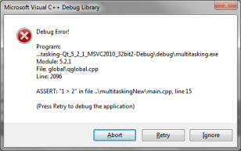
Qt Debugging Aids – Asserts and Debug Dumps
Q_ASSERT is like the good old assert, except that you can compile it out by compiling Qt with the QT_NO_DEBUG flag
Q_ASSERT_X(1 > 2, "main", "False condition");
Uses qFatal()
You can pass a name to each Qt object with setObjectName()
This name can be retrieved with QObject::objectName()
As a lot of the debugging information is only really helpful if these names are set, it is good Qt programming style to do so
Debug dumps
QObject::dumpObjectInfo() dumps information about object internals, like signals/slots
QObject::dumpObjectTree() dumps the parent/child relationships of all descendant objects

Slide 33
Modules and Include files
Qt Modules
QtCore, QtGui, QtWidgets, QtXml, QtSql, QtNetwork, QtTest...
Enable Qt Module in qmake.pro file:
QT += network
Default: qmake projects use QtCore and QtGui
Any Qt class has a header file.
#include <Qlabel>
#include <QtWidgets/QLabel>
Any Qt Module has a header file.
#include <QtGui>

Slide 34
Includes and Compilation Time
Module includes
#include <QtGui>
Precompiled header and the compiler
If not supported may add extra compile time
If supported may speed up compilation
Supported on: Windows, MacOSX, Unix
Class includes
#include <QLabel>
Reduce compilation time
Use class includes (#include <QLabel>)
Forward declarations (class QLabel;)
Place module includes before other includes.

Slide 35
Questions And Answers
What is Qt?
Which code lines do you need for a minimal Qt application?
What is a .pro file?
What is qmake, and when is it a good idea to use it
What is a Qt module and how to enable it in your project
How can you include a QLabel from the QtGui module
Name places where you can find answers about Qt problems

Slide 36
Objects in Qt

Slide 37
Contents
Communication Using Signals & Slots
Signal/Slot Variations
Handling Events in Qt

Slide 38
Objectives
Learn…
... what signals & slots are
... how to use signals & slots for object communication
... which variations for signal/slot connections exist
... how to create custom signals & slots
... how Qt handles events

Slide 39
Communication Using Signals and Slots

Slide 40
Object Communication
Between objects
Signals & Slots
Between Qt and the application
Events
Between Objects on threads
Signal & Slots + Events
Between Applications
D-Bus, sockets, shared files, process standard input/output, QSharedMemory

Slide 41
Callbacks
How do you get from "the user clicks a button" to your business logic?
Possible solutions
Callbacks
Based on function pointers
Not type-safe
Observer Pattern(Listener)
Based on interface classes
Needs listener registration
Many interface classes
Qt uses
Signals and slots for high-level (semantic) callbacks
Virtual methods for low-level (syntactic) events.

Slide 42
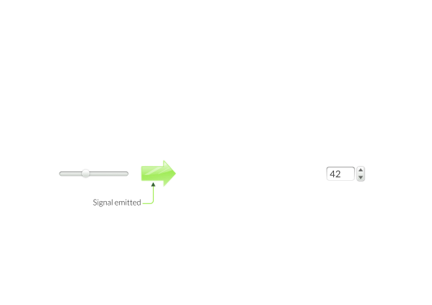
Connecting Signals to Slots

Slide 43
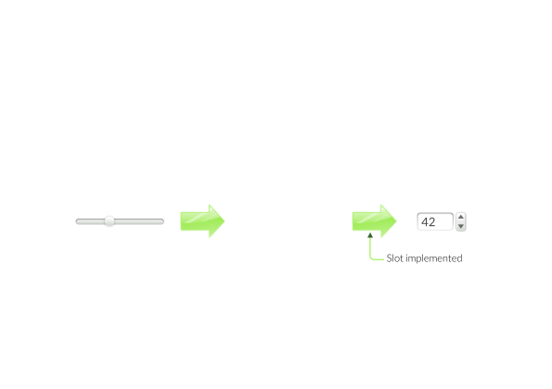
Connecting Signals to Slots

Slide 44
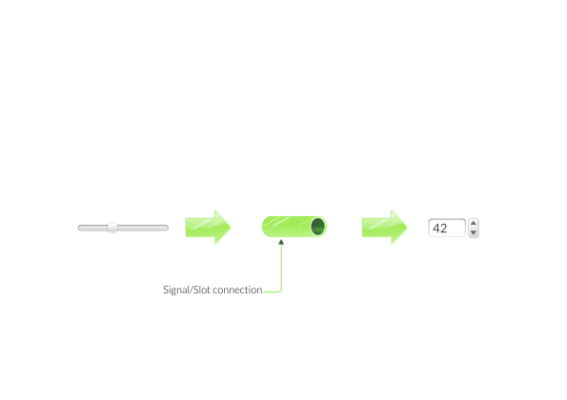
Connecting Signals to Slots

Slide 45
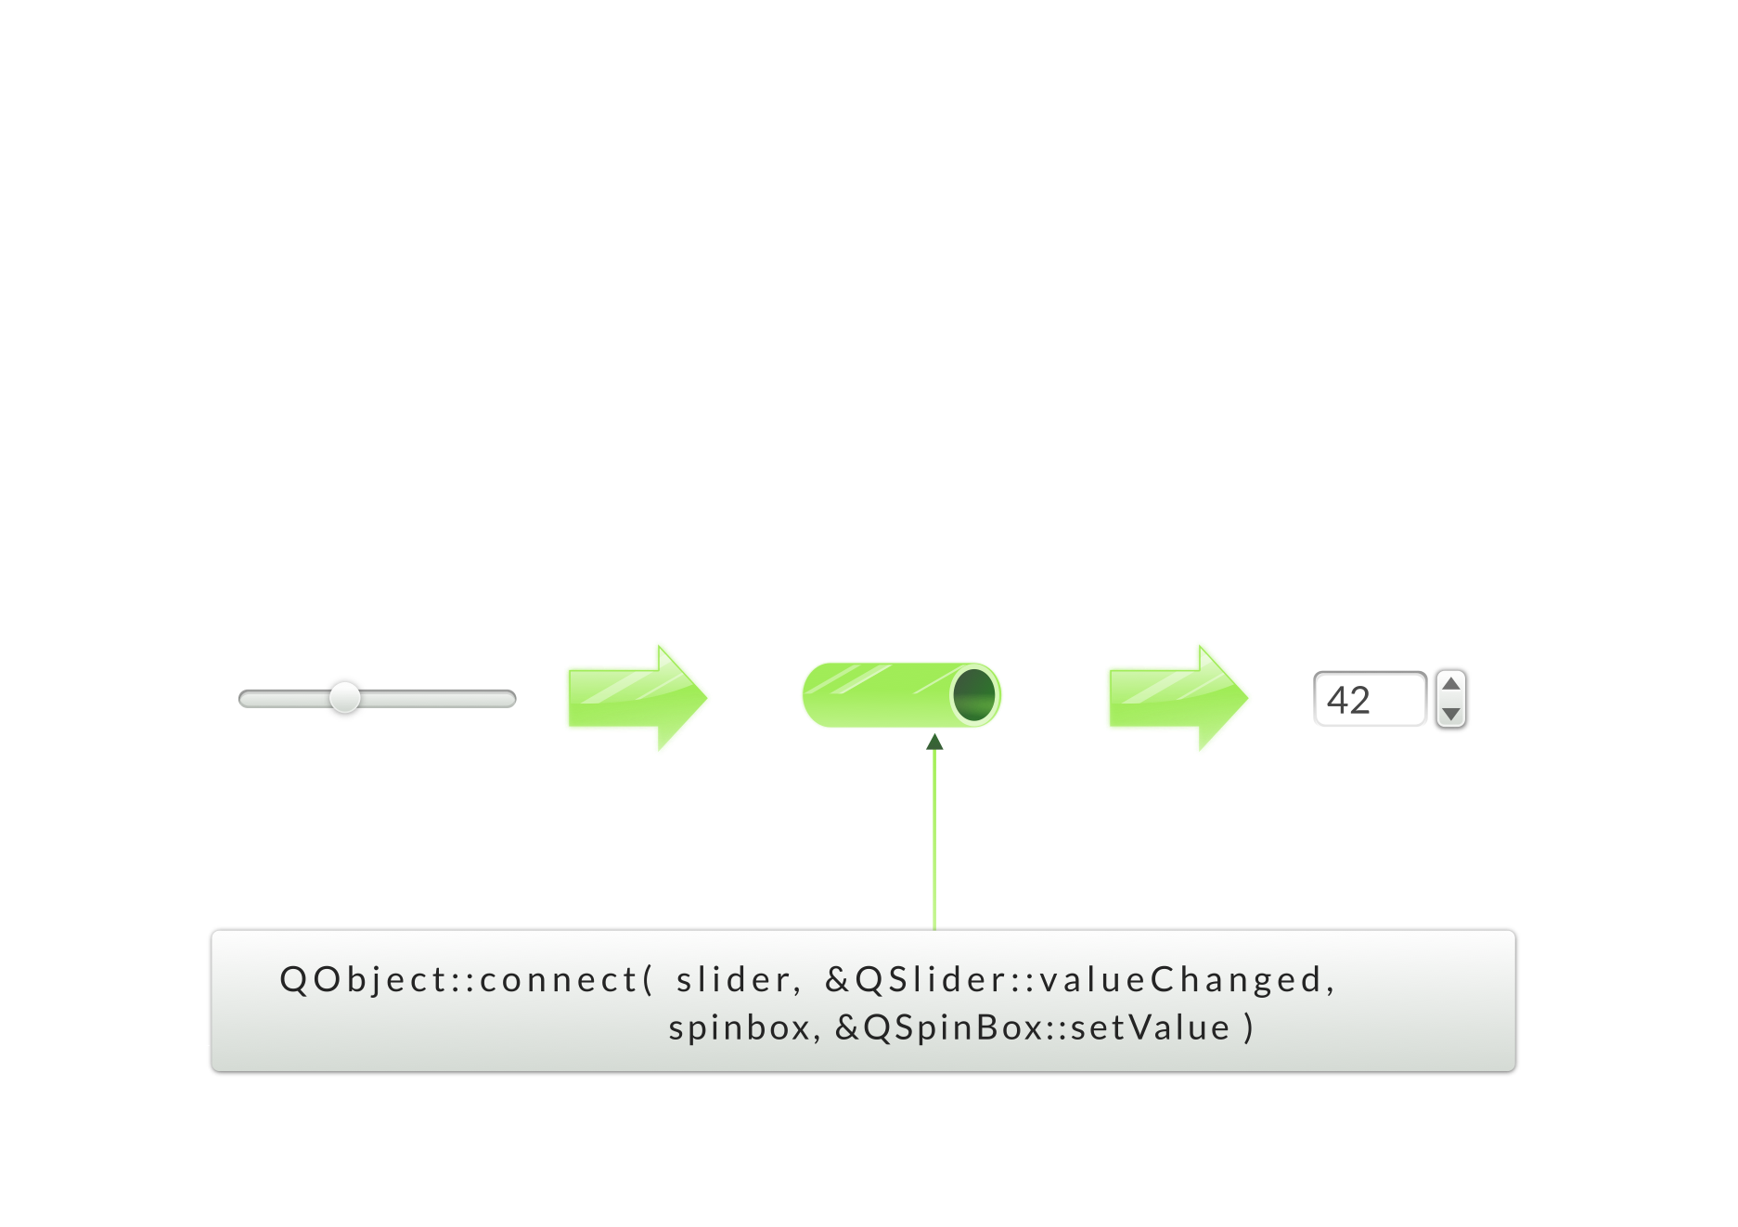
Connecting Signals to Slots

Slide 46
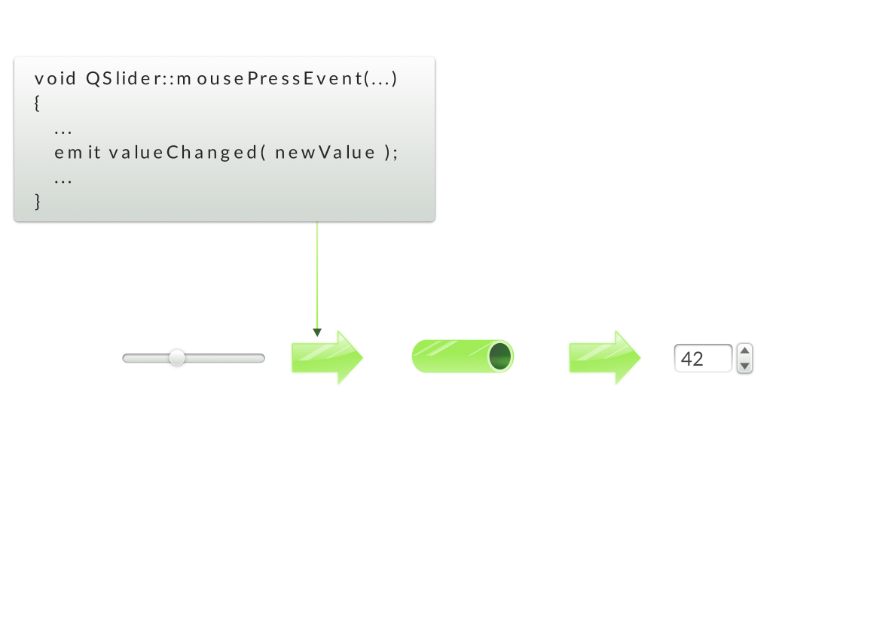
Connecting Signals to Slots

Slide 47
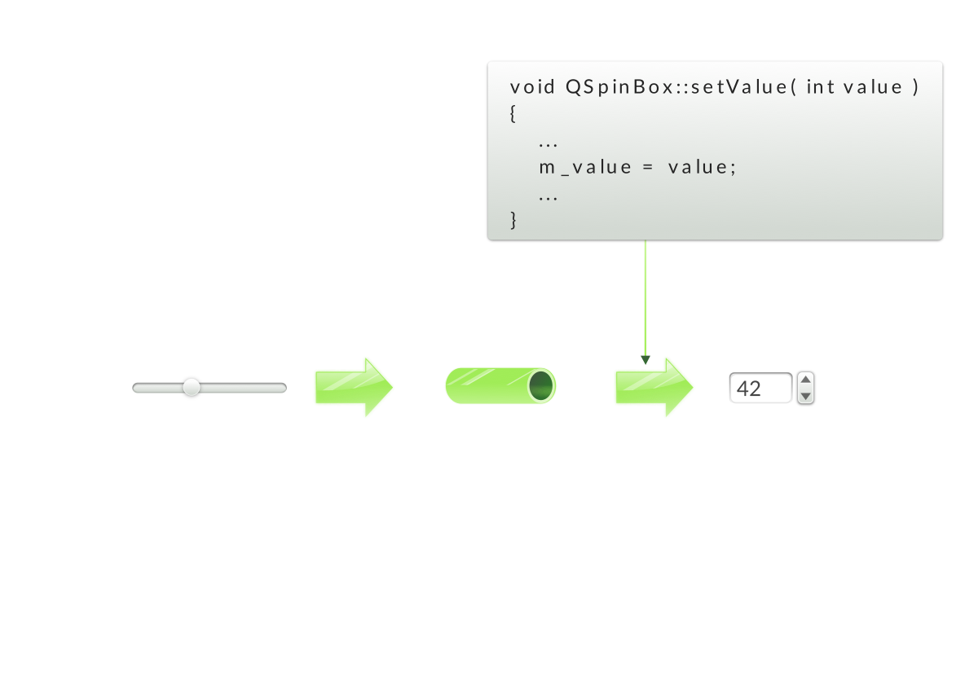
Connecting Signals to Slots

Slide 48
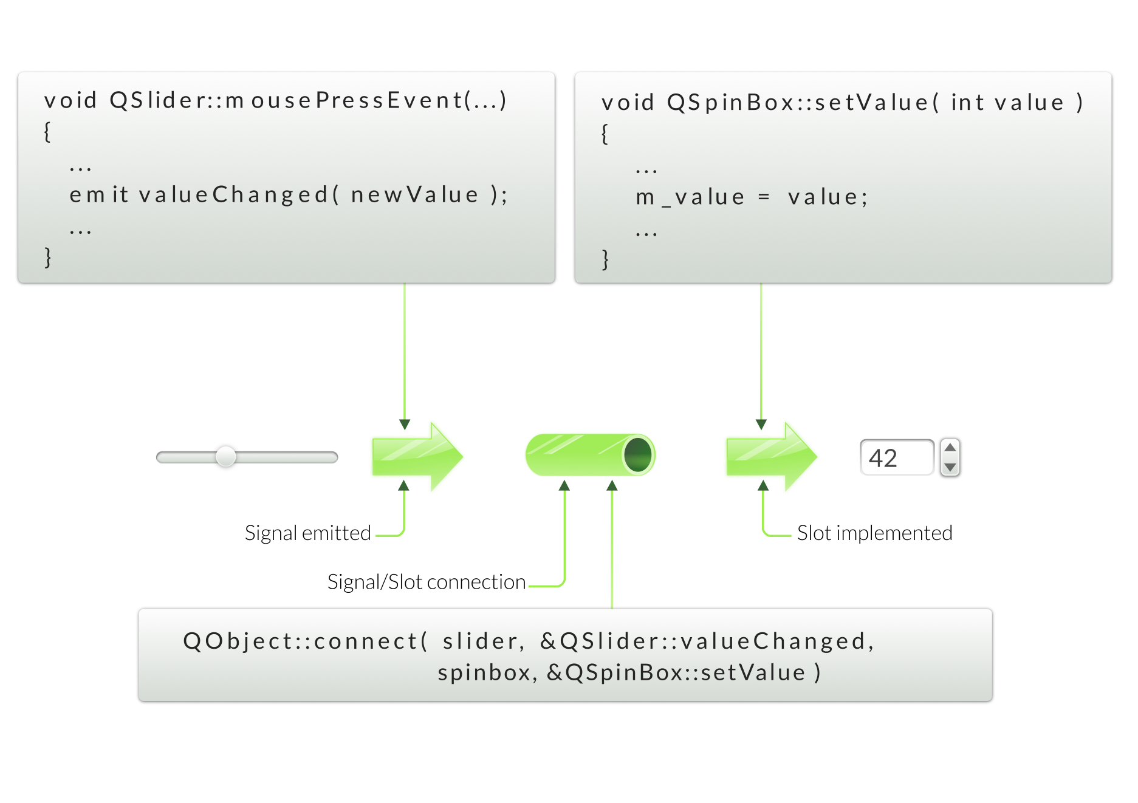
Connecting Signals to Slots
Demo: ex-connect

Slide 49
Signal/Slot Variations

Slide 50
Connection Variants
Qt4 style:
Connect(slider, SIGNAL(valueChanged(int)), spinbox, SLOT(setValue(int)));
Using function pointers:
Connect(slider, &QSlider::valueChanged, spinbox, &QSpinBox::setValue);
Using non-member function:
static void printValue(int value) {...}
Connect(slider, &QSignal::valueChanged, &printValue);
Using C++11 lambda functions:
Connect(slider, &QSlider::valueChanged, [=] (int value) {...} );

Slide 51
Connect – Function Pointers
Qt5 components
Connect(slider, &QSlider::valueChanged, spinbox, &QSpinBox::setValue);
Overloaded functions:
connect(spin, static_cast<void (QSpinBox::*)(int)>
(&QSpinBox::valueChanged), slider, &QSlider::setValue);
Primary choice when connecting objects
√ Compile time errors √ No special syntax for slots
√ Q_OBJECT not need for slots
X connecting to overloaded slots is hard
Demo: ex-connect-function-pointers

Slide 52
Connect – Qt4 Style
Qt4 ported code:
Connect(slider, SIGNAL(valueChanged(int)), spinbox, SLOT(setValue(int)));
Receiving object:
X need to declare the slot in a slots section
X need the Q_OBJECT macro X need to have moc run on it
X Only run time errors √ overloaded slot are easy √ Existing Qt4 code do not need to be rewritten
Demo: ex-connect

Slide 53
Custom Slots - Qt4 Style
File: myclass.h
File: myclass.cpp
class StopWatch : public Qlabel
{
Q_OBJECT
// …
protected Q_SLOTS: // or slots
void shot();
void StopWatch::shot()
{
// Slot implementation
}
Demo: ex-stop-watch

Slide 54
Connect – Non-Member
Using non-member functions:
static void printValue(int value) {
qDebug( "value = %d", value );
}
connect(slider, &QSignal::valueChanged, &printValue);
√ No slots syntax, no Q_OBJECT, no moc √ Compile time errors √ Any function, e.g. the return value of std::bind
Demo: ex-connect-non-member

Slide 55
Connect – Lambda Functions
Using C++11 lambda functions:
Add CONFIG += c++11 to your project file, if needed
connect(slider, &QSlider::valueChanged,
[] (int value) { qDebug("%d", value); });
√ No slots syntax, no Q_OBJECT, no moc √ Compile time errors √ No need for an extra function
Demo: ex-connect-lambda

Slide 56
Custom Signals
File: myclass.h
File: myclass.cpp
No implementation for a signal
Sending a signal
class StopWatch : public Qlabel
{
Q_OBJECT
// …
Q_SIGNALS: // or signals
void valueChanged(int value);
Q_EMIT valueChanged(value)
Demo: ex-quotebutton

Slide 57
Q_OBJECT - Flag for MOC
Q_OBJECT
Enhances QObject with meta-object information
Required for signals
Required for slots when using the Qt4 way
moc creates meta-object information
moc -o moc_myclass.cpp myclass.h
c++ -c myclass.cpp; c++ -c moc_myclass.cpp
c++ -o myapp moc_myclass.o myclass.o
qmake takes care of mocing files for you

Slide 58
Variations of Signal/Slot Connections
Signal | Connect to | Slot(s)
one | √ | many
many | √ | one
one | √ | another signal
Signal to Signal Connection
connect(bt, SIGNAL(clicked()), this, SIGNAL(okSignal()));
Not allowed to name parameters
connect(m_slider, SIGNAL(valueChanged(int value)), this,
SLOT(setValue(int newValue)))

Slide 59
Making the Connection
Rule for Signal/Slot Connection
Can ignore arguments, but not create values from nothing
Signal |  | Slot
rangeChanged(int,int) | √ | setRange(int,int)
rangeChanged(int,int) | √ | setRange(int,int)
rangeChanged(int,int) | √ | update()
valueChanged(int) | √ | setValue(int)
valueChanged(int) | √ | update()
valueChanged(int) | X | setRange(int,int)
valueChanged(int) | √ | setValue(float)
textChanged(QString) | X | setValue(int)

Slide 60
Connection Types
Qt::AutoConnection – the default connection type
Rather useful – especially, if multithreading used
Qt::DirectConnection - An immediate slot function call, if signal and slot implemented in objects in the same thread
Qt::QueuedConnection – An delayed function call (next event loop), if signal and slot implemented in objects in separate threads
Qt::BlockingQueuedConnection – Signaling thread blocks
Qt::UnieuqConnection – Prevents multiple instances of the same connection

Slide 61
Disconnecting Signals
Disconnect everything connected to an object’s signals
disconnect(senderObject, 0, 0, 0); // sender (cannot be 0), signal, receiver, slot
Disconnect everything connected to a specific signal
disconnect(senderObject, &Object::theSignal, 0, 0);
Disconnect a specific receiver
disconnect(senderObject, 0, receiver, 0);
Disconnect a specific connection
disconnect(senderObject, &Object::theSignal, receiver, &Object::theSlot);
If connected to lambda expressions, use the following overloaded version of the disconnect() function:
bool QObject::disconnect(const QMetaObject::Connection &connection);

Slide 62
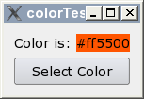
Lab – Connect to Click
Create an application as shown here
Clicking on ”SelectColor” updates label with color's name.
Hints
QColorDialog::getColor()to fetch a color
QColor::name()to get the color name
Optional
In QColorDialog, honor the user clicking ”cancel”', and provide it with the current color to start from.
Set the selected color as the label's background
Hint: see QPalette
Hint: see QWidget::setAutoFillBackground()
Lab: lab-selectcolor

Slide 63
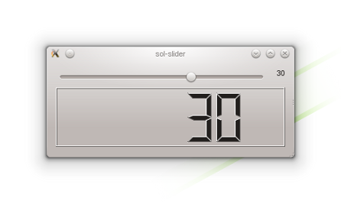
Lab – Source Compatibility
Implement custom slider
API compatible with QSlider
Shows current value of slider
To create custom slider
Use QSlider and QLabel
To test slider
main.cpp provides test code
QLCDNumber is part of test code
Optional:
Discuss pros and cons of inheriting from QSlider instead of using an instance in a layout.
Lab: lab-slider

Slide 64
Handling Events in Qt

Slide 65
Event Processing
Qt is an event-driven UI toolkit
QCoreApplication::exec() runs the event loop
Generate Events
By input devices: keyboard, mouse, etc.
By Qt itself (e.g. timers)
Queue Events
By event loop
Dispatch Events
By QApplication to receiver: QObject
Key events sent to widget with focus
Mouse events sent to widget under cursor
Handle Events
By QObject event handler methods

Slide 66
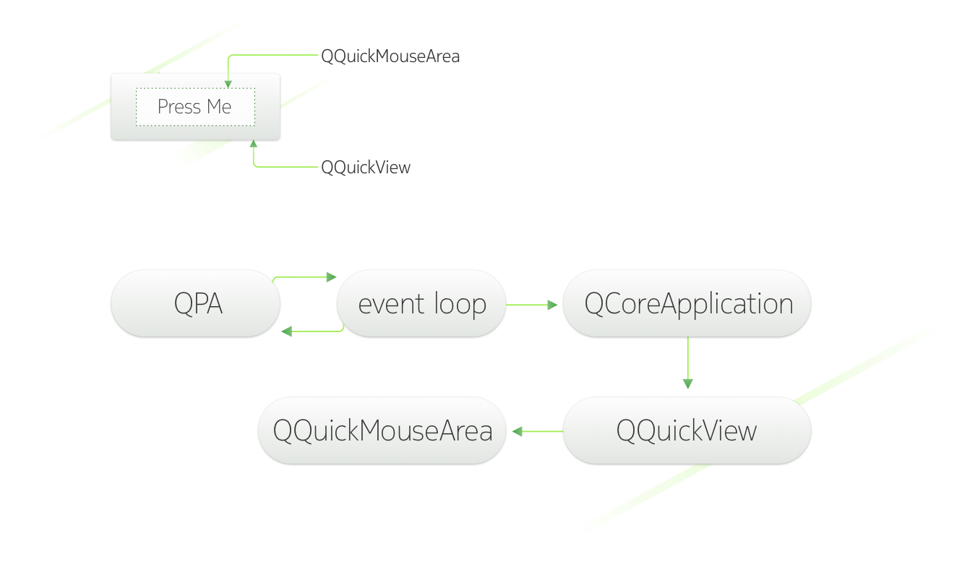
Event Processing

Slide 67
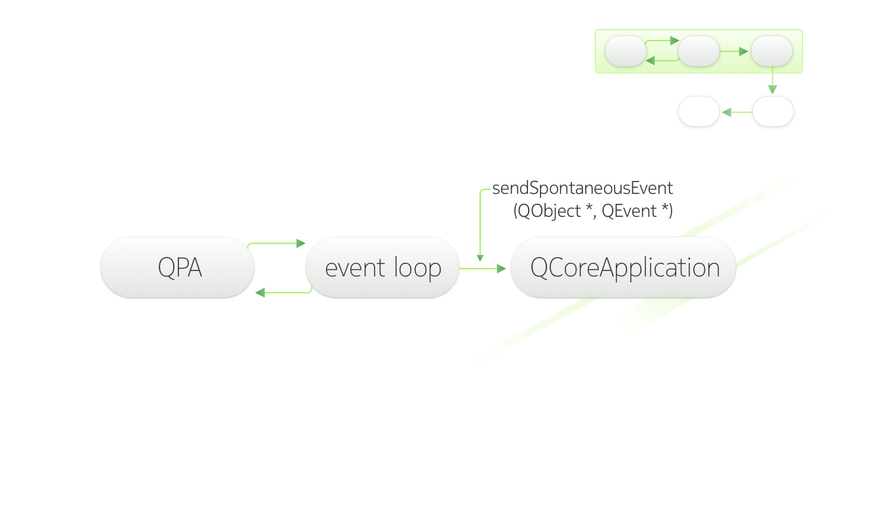
Event Processing

Slide 68
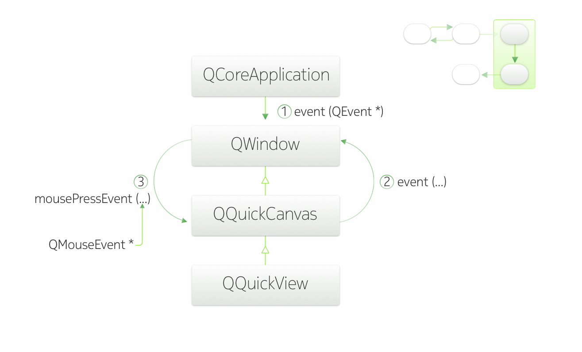
Event Processing

Slide 69
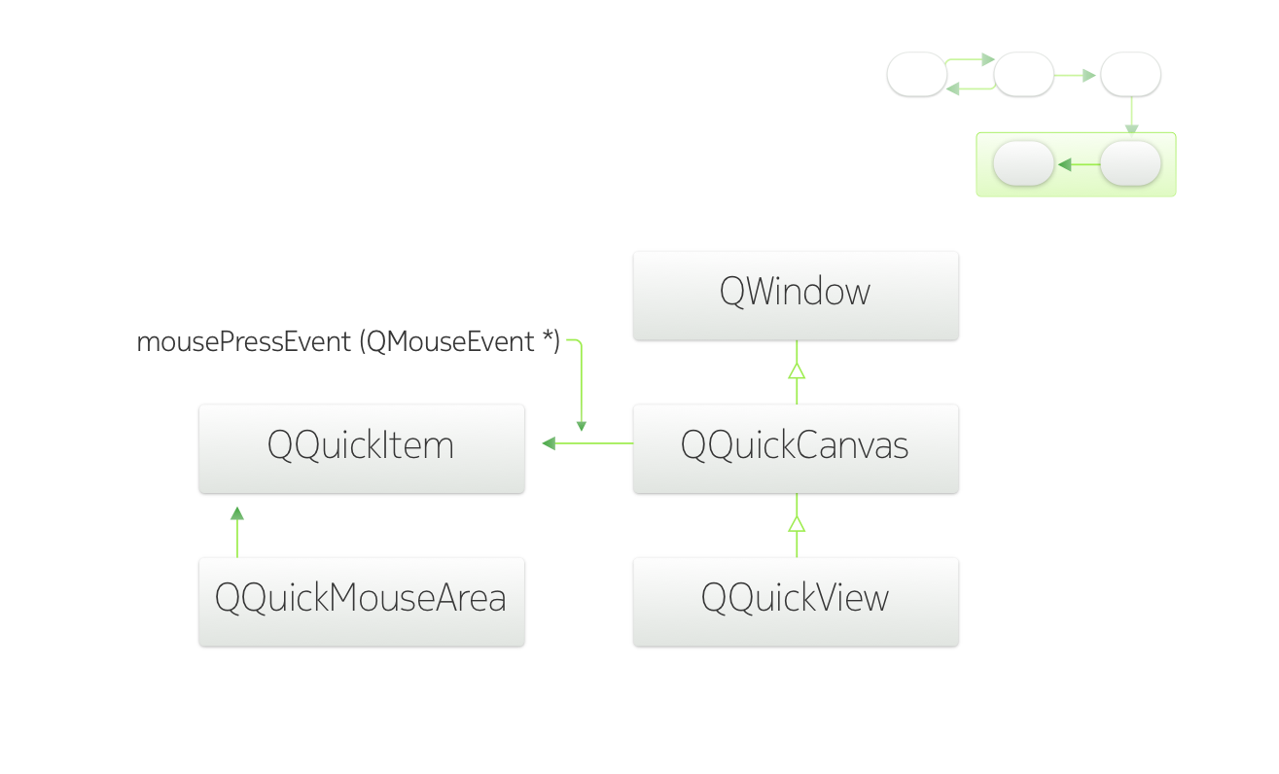
Event Processing

Slide 70
Event Handling
QObject::event(QEvent *event)
Handles all events for this object
Specialized event handlers for QWidget and QQuickItem:
mousePressEvent() for mouse clicks
touchEvent() for touch handling
Accepting an Event
event->accept()/event->ignore()
Accepted is the default.
Event propagation
Happens if event is ignored
Might be propagated to parent widget
Demo: ex-allevents

Slide 71
Example of Event Handling
QCloseEvent delivered to top level widgets (windows)
Accepting event allows window to close
Ignoring event keeps window open
void Widget::closeEvent(QCloseEvent *event)
{
if (windowShouldClose())
event->accept();
else
event->ignore();
}
Demo: ex-closeevent

Slide 72
Multi-Threaded Object Communication
Signal/slots between threads
Posting events using
QCoreApplication::postEvent(QObject* receiver, QEvent* event)

Slide 73
Event Categories
Spontaneous events
Asynchronous, e.g. mouse or key press events
Generated by the underlying window system
Read and queued by a QPA plug-in
Processed by the event loop
Synthetic events
Created in Qt program
Synchronous or asynchronous
Demo: ex-syntheticevents

Slide 74
Synchronous and Asynchronous Events
Asynchronous synthetic events (QCoreApplication::postEvent())
Asynchronous, e.g. signals across threads (Qt::QueuedConnection)
Generated by Qt or the application itself
Queued by Qt and processed by the event loop
More importantly, in some cases system can compress several posted events into one!
Synchronous synthetic events (QCoreApplication::sendEvent())
Synchronous, e.g. calling QWidget::repaint()
Generated by Qt or the application itself
Sent directly to the target object

Slide 75
Sending and Posting Events
Note that you have to have a pointer to the object you are sending/posting the event to
Certain static QApplication functions can be useful in order to retrieve pointers, for example:
QWidget* QApplication::activeWindow(),
QWidget* QAppliation::focusWidget()
Remember that in some cases similar behaviour as sending and posting events can be achieved more simply with signals and slots!

Slide 76
Event Processing – Event Loops
All event loops in Qt are represented by the class QEventLoop
QEventLoop can be used to launch local event loops
The main event loop is launched using QApplication::exec()
Main event loop tells the event dispatcher what to do, how to do it
For example: wait for an event, exclude user input events
Event loop is modal
QApplication::exec(), QEventLoop::exec(), etc. are blocking
QDialog, QMenu also have exec() functions
Continues processing until told to stop by calling exit()
Event-loop is recursive
Any of the exec() functions can re-curse
Except for QApplication::exec()
Use with caution, unexpected recursion can happen

Slide 77
Event Dispatcher
Base class: QAbstractEventDispatcher
Receives events from the window system and other sources via QEventLoop
Delivers events to QCoreApplication
Platform-specific implementations are made by subclassing QAbstractEventDispatcher
QEventDispatcherWin32, QEventDispatcherLinux
Can be used to tie Qt event handling to external or native event loops

Slide 78
Event Filters
Sometimes you need to add the same functionality to a number of different widgets (reacting on a certain event the same way)
…or you might want block/hijack events aimed at a certain widget (e.g. a QPushButton on the screen)
The usual way to do this is to subclass each widget and implement the required event handler function(s)
This is cumbersome if all you try to obtain is the possibility to e.g. add common mouse movement handling to widgets or block certain events
The solution: use one or more event filters

Slide 79
Event Filters
Implementing an event filter is very easy:
Subclass from QObject (or any subclass of QObject) and re-implement the method
bool eventFilter(QObject *receiver, QEvent *event)
This method returns true if the filter handles the given event, false otherwise
The event filter can be installed for any object by invoking the method QObject::installEventFilter()
An application-global event filter can be installed by invoking installEventFilter() on the QCoreApplication instance
Avoid in general because of performance loss
Good for debugging – e.g. is there a certain event type or not?

Slide 80
Further Notes
Events are not handled at all for objects whose thread affinity is NULL (i.e. do not belong to any thread)
An object and its event filter need to be in the same thread (i.e. have the same thread affinity) - otherwise QObject::installEventFilter() does nothing
Furthermore, if one of them is moved to another thread after installation, the event filter will not be called before both are in the same thread again (the filter is not removed by the system)
Demo: ex-eventfilter

Slide 81
Questions And Answers
How do you connect a signal to a slot?
How would you implement a slot?
How would you emit a signal?
Can you return a value from a slot?
When do you need to run qmake
Where do you place the Q_OBJECT macro and when do you need it?
What is the purpose of the event loop
How does an event make it from the device to an object in Qt?

Slide 82
Core Classes

Slide 83
Contents
Qt's Object Model
QObject
QWidget
Variants
Properties
String Handling
Container Classes

Slide 84
Objectives
Learn…
... What the Qt object model is
... The basics of the widget system in C++
... Which utility classes exists to help you in C++

Slide 85
Qt’s C++ Object Model - QObject
QObject is the heart of Qt’s object model
Adds features to C++, like ...
Signals and slots
Properties
Event handling
Memory management
...
Some features are standard C++
Some use Qt’s meta-object system
QObject has no visual representation

Slide 86
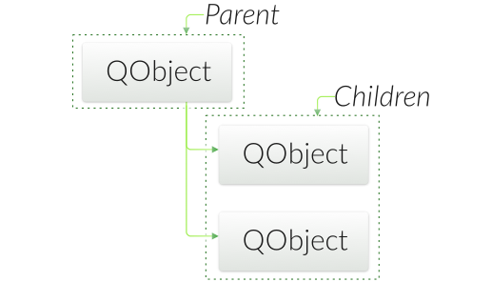
Object Tree
QObjects organize themselves in object trees
Based on parent-child relationship
QObject(QObject *parent = 0)
Parent adds object to list of children
Parent owns children
Construction/Destruction
Tree can be constructed in any order
Tree can be destroyed in any order
if object has parent: object first removed from parent
if object has children: deletes each child first
No object is deleted twice
Note: Parent-child relationship is NOT inheritance

Slide 87
Creating Objects
On Heap - QObject with parent:
QLabel *label = new QLabel("Some Text", parent);
QLayout::addWidget() and QWidget::setLayout() re-parent children automatically
On Stack - QObject without parent:
QFile, usually local to a function
QApplication (local to main())
Top level QWidgets: QMainWindow
On Stack - "value" types
QString name;
QStringList list;
QColor color;
Do not inherit QObject
Passed by value everywhere
Exception: QString is implicitly shared (COW strategy)
Stack or Heap - QDialog - depending on lifetime

Slide 88
QObject Lifetime – Non–Shared Objects
QPointer
Guarded pointer to QObject
Solves the dangling pointer problem
Easy to mix guarded and normal pointers, guarded pointer automatically cast to the pointer type
QScopedPointer
Destructs the objects, when the pointer goes out of the scope,
No copy constructor
Use case: Exception handling – several exit paths in the function
// ExampleObject is just QObject subclass
QPointer<ExampleQObject> object(new ExampleQObject);
delete object;
if (object)
qDebug() << "Crash";
else
qDebug() << "No dangling pointer";

Slide 89
QObject Lifetime – Shared Objects
QSharedPointer and QWeakPointer
Strong and weak references (reference may become null at any moment) to an object
No need to worry, who deletes the object and when
Thread safe in terms of reference counting
Thread-safe reference counting but the object pointed to is not thread-safe
Copy constructor
QSharedDataPointer and QExplicitlySharedDataPointer
For implicit (and explicit) data sharing
Similar to QSharedPointer except copy the shared data (implicitly/explicitly)
Used typically with QSharedData
QSharedPointer<MyObj> object =
QSharedPointer<MyObj>(new MyObj, &QObject::deleteLater);

Slide 90
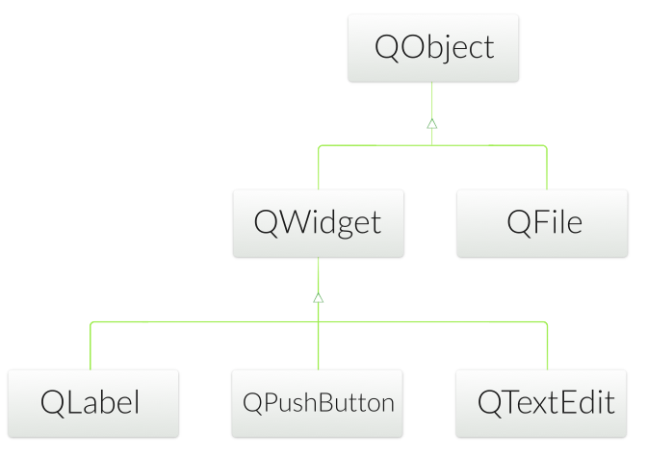
Qt’s Widget Model - QWidget
Derived from QObject
Adds visual representation
Base of user interface objects
Receives events
e.g. mouse, keyboard events
Paints itself on screen
Using styles

Slide 91
Object Tree and QWidget
new QWidget(0)
Widget with no parent = "window"
QWidget’s children
Positioned in parent’s coordinate system
Clipped by parent’s boundaries
QWidget parent
Propagates state changes
hides/shows children when it is hidden/shown itself
enables/disables children when it is enabled/disabled itself
Tristate mechanism
For hide/show and enable/disable, ensures that e.g. an explicitly hidden child is not shown when the parent is shown.

Slide 92
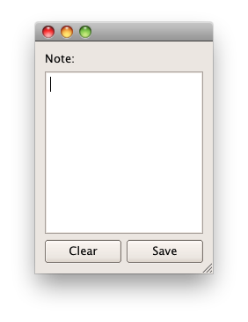
Widgets that Contain Other Widgets
Container Widget
Aggregates other child-widgets
Use layouts for aggregation
In this example: QHBoxLayout and QVBoxLayout
Note: Layouts are not widgets
Layout Process
Add widgets to layout
Layouts may be nested
Set layout on container widget

Slide 93

Example Container Widget
void DemoWidget::addButtons(QLayout *layout)
{
layout->addWidget(new QPushButton("One"));
layout->addWidget(new QPushButton("Two"));
layout->addWidget(new QPushButton("Three"));
layout->addWidget(new QPushButton("Four"));
layout->addWidget(new QPushButton("Five"));
}
void DemoWidget::createHBoxLayout()
{
QHBoxLayout *layout = new QHBoxLayout;
addButtons(layout);
setLayout(layout);
}
int main(int argc, char *argv[]) {
QApplication app(argc, argv);
DemoWidget row;
row.createHBoxLayout();
row.show();
return app.exec();
}
Demo: ex-layout

Slide 94
QVariant
QVariant
Union for common Qt "value types” (copyable, assignable)
Supports implicit sharing (fast copying)
Supports user types
QVariant property(const char* name) const;
void setProperty(const char* name, const QVariant &value);
class QAbstractItemModel {
virtual QVariant data( const QModelIndex& index, int role );
/// ...
}

Slide 95
QVariant
For QtCore types
For non-core and custom types
QVariant variant(42);
int value = variant.toInt(); // read back
qDebug() << variant.typeName(); // int
QVariant variant = QVariant::fromValue(QColor(Qt::red));
QColor color = variant.value<QColor>(); // read back
qDebug() << variant.typeName(); // "QColor"

Slide 96
Custom Data Types in Variants
Type must support default construction, copy and assignment.
Q_DECLARE_METATYPE should be used after class definition in header file.
#include <QMetaType>
class Contact {
public:
void setName(const QString & name);
QString name() const;
// ...
};
Q_DECLARE_METATYPE(Contact);

Slide 97
Custom Data Types in Variants
#include <QCoreApplication>
#include "Contact.h"
#include <QVariant>
#include <QDebug>
int main(int argc, char *argv[])
{
QCoreApplication a(argc, argv);
Contact contact;
contact.setName("Peter");
const QVariant variant = QVariant::fromValue(contact);
const Contact cotherContact = variant.value<Contact>();
qDebug() << cotherContact.name();
qDebug() << variant.typeName();
return 0;
}
Demo: ex-customtypes

Slide 98
Using the Type Id
int main(int argc, char* argv[])
{
// Get the id of Contact
const int typeId = qMetaTypeId<Contact>();
Contact contact;
contact.setName("Peter");
// Create copy of object in a generic way
void *object = QMetaType::construct(typeId, &contact);
Contact *otherContact = reinterpret_cast<Contact *>(object);
qDebug() << otherContact->name();
return 0;
}

Slide 99
Properties
Qt Quick example
Direct access (Broken, due to private headers)
Generic property access:
Rectangle {
objectName: "myRect"; height: 100
// ...
}
QuickRectangle* rectangle = root->findChild<QQuickRectangle*>("myRect");
int height = rectangle->height();
// Using findChild is almost always a bad idea!
QObject* rectangle = root->findChild<QObject*>("myRect");
int height = rectangle->property("height").value<int>();

Slide 100
Getting to the Root
The root object is the top level element in the QML document
QQuickItem *root = view.rootItem()->childItems().first();
// From previous slide:
QObject* rectangle = root->findChild<QObject*>("myRect");
int height = rectangle->property("height").value<int>();

Slide 101
Providing Properties from QObject
class Customer : public QObject
{
Q_OBJECT
Q_PROPERTY(QString id READ getId WRITE setId NOTIFY idChanged)
Q_PROPERTY(QObject *example MEMBER m_example NOTIFY exampleChanged
public:
QString getId() const;
void setId(const QString& id);
signals:
void idChanged();
void exampleChanged();
private:
QObject *m_member;
// …
};

Slide 102
Enum Properties
class Customer : public QObject
{
Q_OBJECT
Q_PROPERTY(CustomerType type READ getType
WRITE setType NOTIFY typeChanged)
public:
enum CustomerType {
Corporate, Individual, Educational, Government
};
Q_ENUMS(CustomerType);
//...
};

Slide 103
Properties
Q_PROPERTY is a macro:
Property access methods:
If name is not declared as a Q_PROPERTY
->dynamic property
Not accessible from Qt Quick
Note:
Q_OBJECT macro required for properties to work
QMetaObject knows nothing about dynamic properties
Q_PROPERTY( type name READ getFunction [WRITE setFunction]
[RESET resetFunction] [NOTIFY notifySignal] [DESIGNABLE bool]
[SCRIPTABLE bool] [STORED bool] )
QVariant property(const char* name) const;
void setProperty(const char* name, const QVariant &value);

Slide 104
Using Properties
QMetaObject support property introspection
aconst QMetaObject *metaObject = object->metaObject();
const QString className = metaObject->className();
const int propertyCount = metaObject->propertyCount();
for ( int i=0; i<propertyCount; ++i ) {
const QMetaProperty metaProperty = metaObject->property(i);
const QString typeName = metaProperty.typeName()
const QString propertyName = metaProperty.name();
const QVariant value = object->property(metaProperty.name());
}
Demo: ex-properties

Slide 105
String Handling

Slide 106
Text Processing with QString
Strings can be created in a number of ways:
Conversion constructor and assignment operators:
QString str("abc");
str = "def”;
From a number using a static function:
QString n = QString::number(1234);
From a char pointer using the static functions:
QString text = QString::fromLatin1("Hello Qt");
QString text = QString::fromUtf8(inputText);
QString text = QString::fromLocal8Bit(cmdLineInput);
QString text = QStringLiteral("Literal string"); (Assumed to be UTF-8)
From char pointer with translations:
QString text = tr("Hello Qt");

Slide 107
Text Processing with QString
operator+ and operator+=
QString str = str1 + str2;
fileName += ".txt";
simplified() // removes duplicate whitespace
left(), mid(), right() // part of a string
leftJustified(), rightJustified() // padded version
QString s = "apple";
QString t = s.leftJustified(8, '.'); // t == "apple..."

Slide 108
Text Processing with QString
Data can be extracted from strings.
Numbers:
QString text = ...;
nt value = text.toInt();
float value = text.toFloat();
Strings:
QString text = ...;
QByteArray bytes = text.toLatin1();
QByteArray bytes = text.toUtf8();
QByteArray bytes = text.toLocal8Bit();

Slide 109
Formatted Output with QString::arg()
int i = ...; int total = ...; QString fileName = ...; QString status = tr("Processing file %1 of %2: %3”)
.arg(i).arg(total).arg(fileName);
double d = 12.34;
QString str = QString::fromLatin1("delta: %1").arg(d,0,'E',3);
// str == "delta: 1.234E+01"
Safer: arg(QString,...,QString)(“multi-arg()”).
But: only works with QString arguments.

Slide 110
Text Processing with QString
Obtaining raw character data from a QByteArray:
char *str = bytes.data();
const char *str = bytes.constData();
WARNING:
Character data is only valid for the life time of the byte array.
Calling a non-const member of bytes also invalidates ptr.
Either copy the character data or keep a copy of the byte array.

Slide 111
Text Processing with QString
length()
endsWith() and startsWith()
contains(), count()
indexOf() and lastIndexOf()
Expression can be characters, strings, or regular expressions

Slide 112
Text Processing with QStringList
QString::split(), QStringList::join()
QStringList::replaceInStrings()
QStringList::filter()

Slide 113
Text Processing with Regular Expressions
QRegularExpression supports
Regular expression matching
Wildcard matching
QRegularExpression rx("^\\d\\d?$"); // match integers 0 to 99
rx.match("123"); // QRegularExpressionMatch(Valid, no match)
rx.match("-6"); // QRegularExpressionMatch(Valid, no match)
rx.match("6"); // QRegularExpressionMatch(Valid, has match: 0:(0, 1, "6"))

Slide 114
Container Classes

Slide 115
Container Classes
General purpose template-based container classes
QList<QString> - Sequence Container
Other: QLinkedList ,QStack, QQueue...
QMap<int, QString> - Associative Container
Other: QHash, QSet, QMultiMap, QMultiHash
Qt's Container Classes compared to STL
Lighter, safer, and easier to use than STL containers
If you prefer STL, feel free to continue using it.
Methods exist that convert between Qt and STL
e.g. you need to pass std::list to a Qt method

Slide 116
Using Containers
Using QList
Using QMap
QList<QString> list;
list << "one" << "two" << "three";
QString item1 = list[1]; // "two"
for(int i=0; i<list.count(); i++) {
const QString &item2 = list.at(i);
}
int index = list.indexOf("two"); // returns 1
QMap<QString, int> map;
map["Norway"] = 5; map["Italy"] = 48;
int value = map["France"]; // inserts key if not exists
if(map.contains("Norway")) {
int value2 = map.value("Norway"); // recommended lookup
}

Slide 117
Algorithm Complexity
How fast is a function when number of items grow?
Sequential Container (all complexities are amortized )
Associative Container (all complexities are amortized )
 | Lookup | Insert | Append | Prepend
QList | O(1) | O(n) | O(1) | O(1)
QVector | O(1) | O(n) | O(1) | O(n)
QLinkedList | O(n) | O(1) | O(1) | O(1)
 | Lookup | Insert
QMap | O(log(n)) | O(log(n))
QHash | O(1) | O(n)

Slide 118
Storing Classes in Qt Container
Class must be anassignable data type
Class is assignable, if:
If copy constructor or assignment operator is not provided
C++will provide one (uses member copying)
If no constructors provided
Empty default constructor provided by C++
class Contact {
public:
Contact() {} // default constructor
Contact(const Contact &other); // copy constructor
// assignment operator
Contact &operator=(const Contact &other);
};

Slide 119
Requirements on Container Keys
Type K as key for QMap:
Type K as key for QHash or QSet:
bool K::operator<( const K& )
bool operator<( const K&, const K& )
bool Contact::operator<(const Contact& c);
bool operator<(const Contact& c1, const Contact& c2);
bool K::operator==( const K& )
bool operator==( const K&, const K& )
uint qHash( const K& )

Slide 120
Iterators
Allow reading a container's content sequentially
Java-style iterators: simple and easy to use
QListIterator<...> for read
QMutableListIterator<...> for read-write
STL-style iterators slightly more efficient
QList::const_iterator for read
QList::iterator() for read-write
Same works for QSet, QMap, QHash, ...

Slide 121
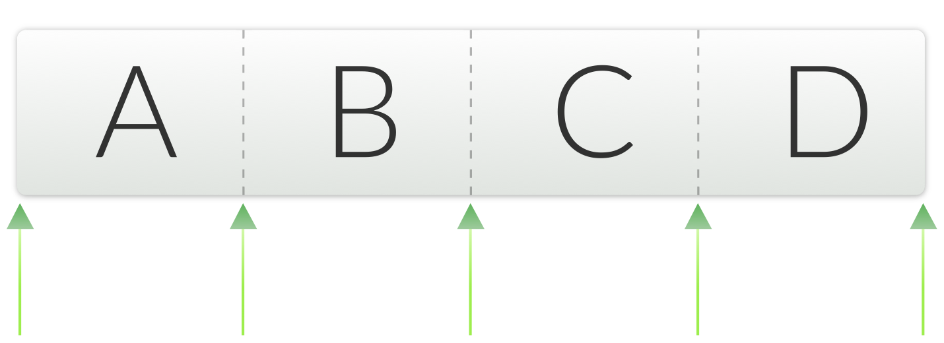
Iterators Java style
Example QList iterator
QList<QString> list;
ist << "A" << "B" << "C" << "D";
QListIterator<QString> it(list);
Forward iteration
while(it.hasNext()) {
qDebug() << it.next(); // A B C D
}
Backward iteration
it.toBack(); // position after the last item
while(it.hasPrevious()) {
qDebug() << it.previous(); // D C B A
}

Slide 122
Modifying During Iteration
Use mutable versions of the iterators (e.g. QMutableListIterator)
remove() and setValue()
Operate on items just jumped over using next()/previous()
insert()
Inserts item at current position in sequence
previous() reveals just inserted item
QList<int> list;
list << 1 << 2 << 3 << 4;
QMutableListIterator<int> i(list);
while (i.hasNext()) {
if (i.next() % 2 != 0)
i.remove();
}
// list now 2, 4

Slide 123
Iterating Over QMap and QHash
next() and previous()
Return Item class with key() and value()
Alternatively use key() and value() from iterator
QMap<QString, QString> map;
map["Paris"] = "France";
map["Guatemala City"] = "Guatemala";
map["Mexico City"] = "Mexico";
map["Moscow"] = "Russia";
QMutableMapIterator<QString, QString> i(map);
while (i.hasNext()) {
if (i.next().key().endsWith("City"))
i.remove();
}
// map now "Paris", "Moscow"
Demo: ex-containers

Slide 124
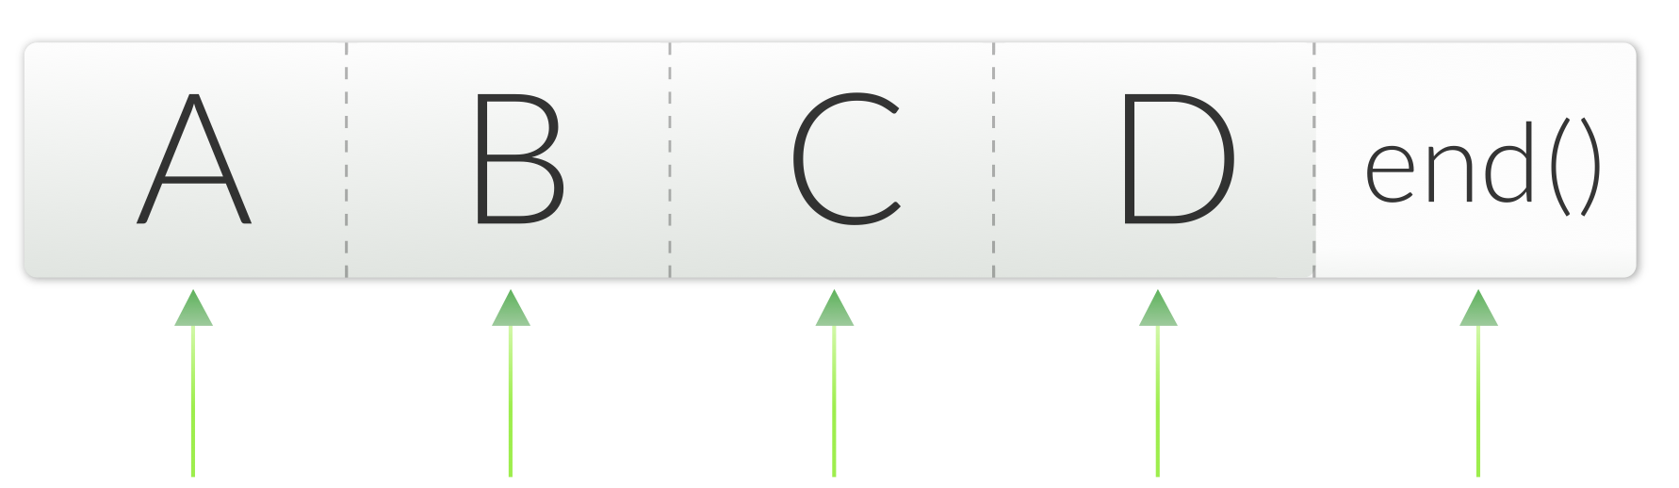
STL-style Iterators
Example QList iterator
QList<QString> list;
ist << "A" << "B" << "C" << "D";
QListIterator<QString> it(list);
Forward mutable iteration
for (i = list.begin(); i != list.end(); ++i) {
*i = (*i).toLower();
}
Backward mutable iteration
i = list.end(); while (i != list.begin()) {
--i;
*i = (*i).toLower();
}

Slide 125
The Q_FOREACH Keyword
It is a macro, feels like a keyword
Q_FOREACH (const QString& str, list) {
if (str.isEmpty())
break;
qDebug() << str;
}
break and continue as normal
Modifying the container while iterating
Results in container being copied
Iteration continues in unmodified version
Not possible to modify item
Iterator variable is a const reference

Slide 126
Algorithms
STL-style iterators are compatible with the STL algorithms
Defined in the STL <algorithm> header
Qt has own algorithms
Defined in <QtAlgorithms> header
Mostly deprecated!
If STL is available on all your supported platforms you can choose to use the STL algorithms
The collection is much larger than the one in Qt.

Slide 127
Algorithms
qSort(begin,end) sort items in range
qFind(begin,end,value) find value
qEqual(begin1,end1,begin2) checks two ranges
qCopy(begin1,end1,begin2) from one range to another
qCount(begin,end,value,n) occurrences of value in range
And more...

Slide 128
Algorithms
Counting 1's in list
For parallel (i.e. multi-threaded) algorithms use QtConcurrent name space
QList<int> list;
list << 1 << 2 << 3 << 1;
int count = 0;
qCount(list, 1, count); // count the 1's
qDebug() << count; // 2 (means 2 times 1)

Slide 129
Algorithms
Copy list to vector example
Case insensitive sort example
QList<QString> list;
list << "one" << "two" << "three";
QVector<QString> vector(3);
qCopy(list.begin(), list.end(), vector.begin());
// vector: [ "one", "two", "three" ]
bool lessThan(const QString& s1, const QString& s2) {
return s1.toLower() < s2.toLower();
}
QList<QString> list;
list << "AlPha" << "beTA" << "gamma" << "DELTA";
qSort(list.begin(), list.end(), lessThan);
// list: [ "AlPha", "beTA", "DELTA", "gamma" ]

Slide 130
Implicitly Sharing and Containers
Implicit Sharing
If an object is copied, then its data is copied only when the data of one of the objects is changed
Shared class has a pointer to shared data block
Shared data block = reference counter and actual data
Assignment is a shallow copy
Changing results into deep copy (detach)
QList<int> l1, l2; l1 << 1 << 2;
l2 = l1; // shallow-copy: l2 shares date with l1
l2 << 3; // deep-copy: change triggers detach from l1
Important to remember when inserting items into a container, or when returning a container.

Slide 131
Questions And Answers
Explain how object ownership works in Qt?
What are the key responsibilities of QObject?
What does it mean when a QWidget has no parent?
What is the purpose of the class QVariant?
What do you need to do to support properties in a class?
Name the different ways to go through the elements in a list, and discuss advantages and disadvantages of each method.

Slide 132
Thank You!
www.qt.io

